Slide 1
Effect of Digital Divide in India and Government initiatives to mitigate it.
By:
Hikmatullah Nasiri 11816103
Mohammad Sabir 11815937

Slide 2
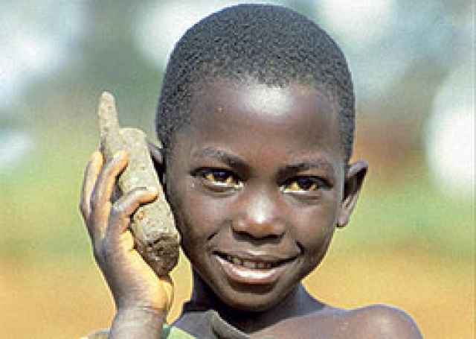
Introduction
The term digital divide refers to the difference in terms of access to and usage of information and communication technology.
Digital divide creates a knowledge gap when one group of people have more access to digital resources like the internet, computers, smartphones so on, better informed and more educated about new developments and inventions compare to another group of people who have neither access to these things or have limited access.

Slide 3


Slide 4
Digital Divide in India

Slide 5
new media technology like the computer, television, radio and especially the Internet have been advancing rapidly. Society has benefited due to Information and Communication Technology (ICT) resulting in people’s lives being made more convenient.
The life of a typical citizen residing in the rural parts of India consists of farming and doing handicraft jobs. The people there often do not have any access to any form of technology. While most people in the world have Internet access privileges, some do not even have computers

Slide 6
Though India is the country which has the second highest number of Facebook users in the world
Internet penetration across the entire population is still below 10 percent according to the Internet and Mobile Association of India (IAMAI).
about 70 percent of Indians live in rural areas, where 65 percent of the working population are farmers.

Slide 7
The main problem is that these 70 percent have an extremely difficult time obtaining electricity in villages. Without electricity, there is no internet.
Technology and other electronic gadgets will not be able to function without electricity

Slide 8
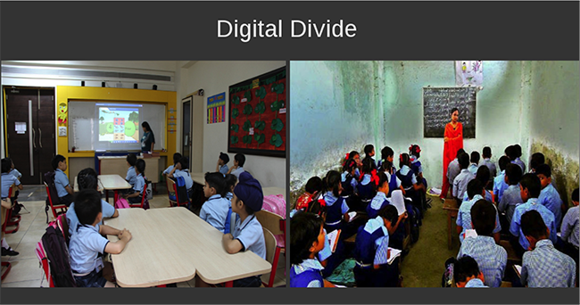
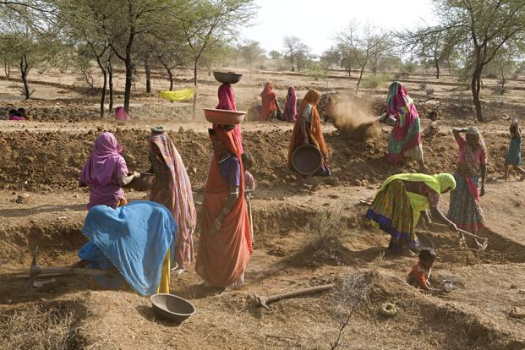

Slide 9
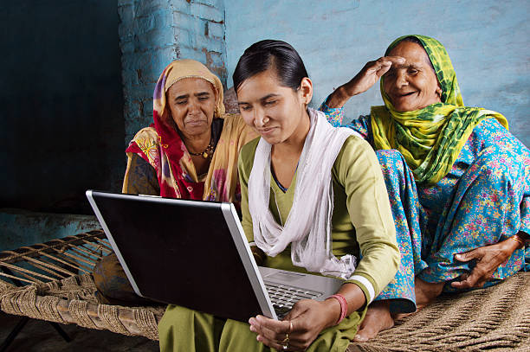
A PICTURE IS WORTH A THOUSAND WORDS

Slide 10
Challenges and Barriers to Bridging the Digital Divide

Slide 11
Infrastructural barriers: India still lacks a robust telecommunication infrastructure with sufficient reliable bandwidth for Internet connection.
Literacy and skill barriers: Education in information literacy will play an important role in keeping the society from fragmenting into a population of information haves and have-nots. The lack of skill in using computer and communication technology also prevents people from accessing digital information.

Slide 12
Economic barriers: Poor access to computer and communication technology also causes a digital divide. In India, the ability to purchase or rent the tool for access to digital information is less among the masses.
Content barriers: To solve the digital divide, steps should be taken by the government to ensure that all citizens are able to receive diverse content relevant to their lives as well as to produce their own content for their communities and for the Internet.
Language barriers: Having a multicultural and multilingual population, today a large percentage of information content on the Internet is in English, which is a barrier for the people whose primary language is not English.

Slide 13
Suggestions
Literacy – Steps should be taken towards making people digitally literate. Example – ‘One library per village’ program.
Training – Making rural population familiar with the use of computer and basic functions. Example – National Science Digital Library: provides cheaper access to science and technology books.
Accessibility– Making the internet accessible to all. Example: National Optical Fiber Network: to ensure broadband connectivity.

Slide 14
Affordability – Reducing phone prices and internet service prices.
Push and motivate citizenry to make use of information and communication technology (ICT) mechanisms.
Reducing the trust deficit that people have with respect to IT enabled services – One come across individuals who would not use ATM but rather visit a bank branch and withdraw money.

Slide 15
CONCLUSION
In conclusion, in order for the citizens living in the rural part of India to be able to keep up with the latest technology, technological workshops are organized to help the Indian workers and their families to make their lives easier. Electricity too plays the most vital role. In addition, wireless mesh networks are also being implemented for tribal children to obtain education. The internet is becoming a necessity throughout the world, and no longer a privilege.

Slide 16
THANKS!
Any questions?

Slide 17
CREDITS
Special thanks to Miss Bhanu Sharma Professor Assistant
Presentation template by SlidesCarnival

